Slide 1
Style Transfer for Anime Sketches with Enhanced Residual U-net and Auxiliary Classifier GAN

Slide 2
Group Members:-
Ayesha Khatun Rima(011 163 117)
Farhana Meem (011 171 031 )
A.B.M. Naveed Hossain(011 163 125)
Noibedya Narayan Ray(011 163 101)

Slide 3
Introduction
Purpose
Motives

Slide 4
Our contributions are:
A feed-forward network to apply the style of a painting to a sketch.
An enhanced residual U-net capable of handling paired
images with unbalanced information quantity.
An effective way to train residual U-net with two additional
loss.
A discriminator modified from AC-GAN suitable to
deal with paintings of different style.

Slide 5
U-Net
AC-GAN

Slide 6
U-Net
Image Segmentation
CNN(Cumulative Neural Networking)

Slide 7
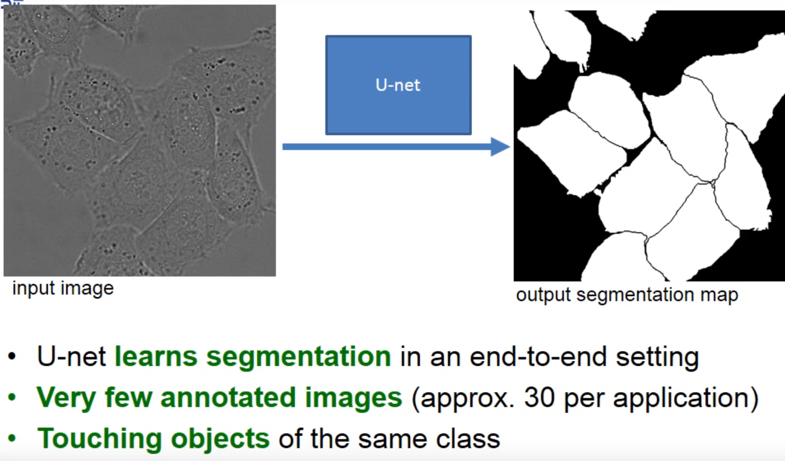
BioMedical Image Segmentation

Slide 8
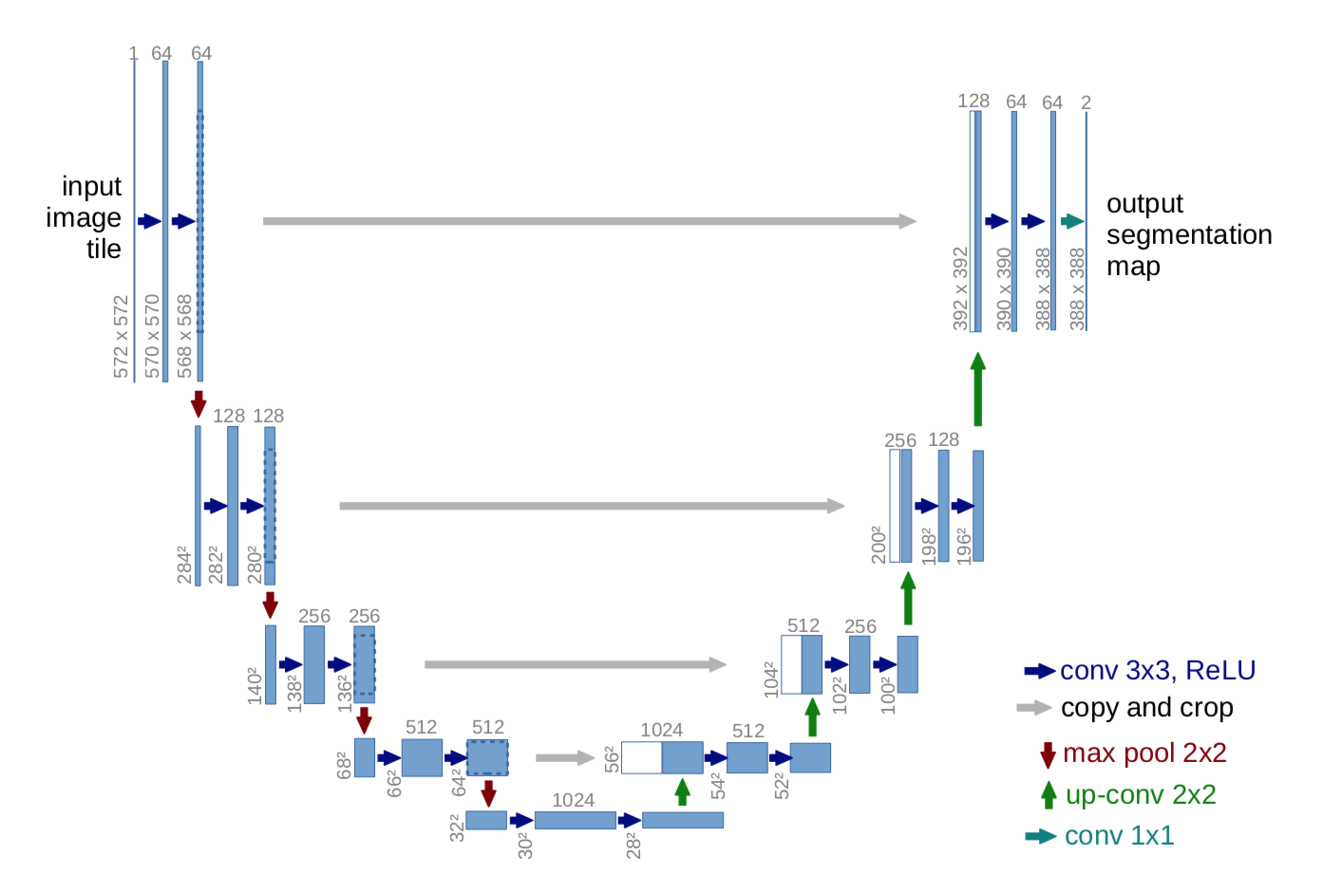
U-Net Architecture

Slide 9
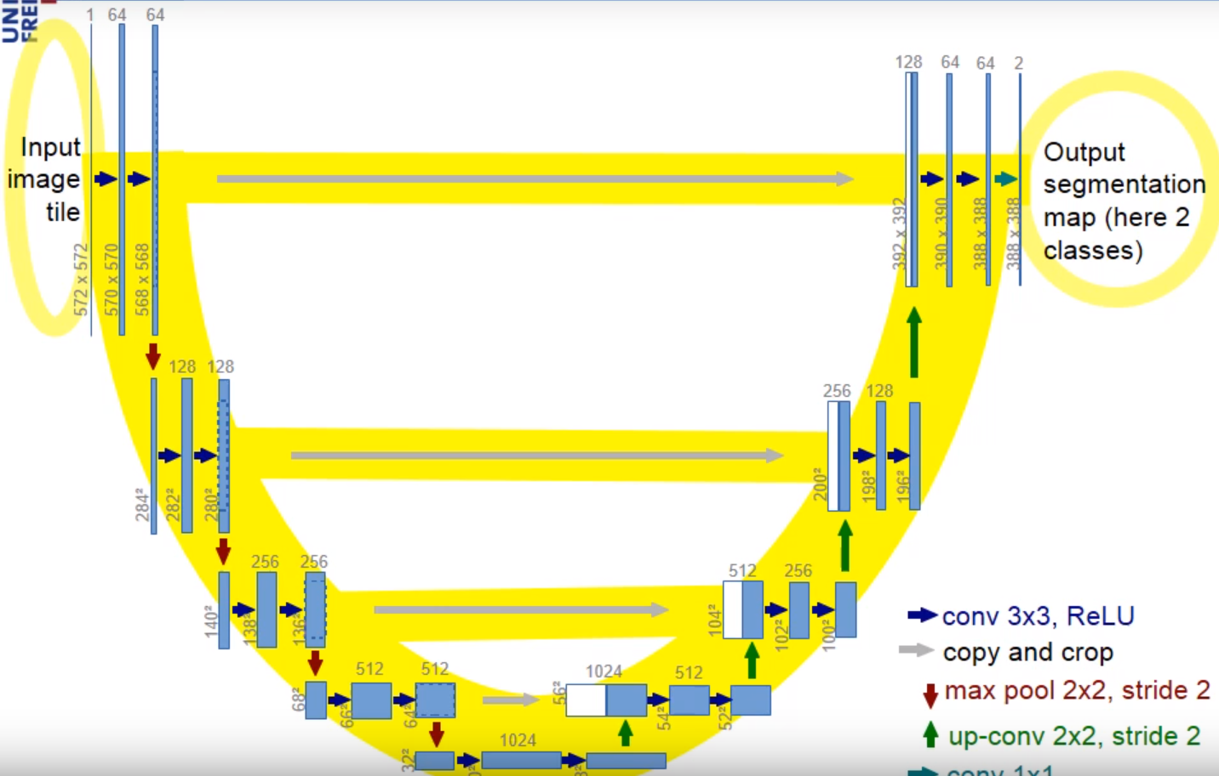
U-Net Architecture

Slide 10
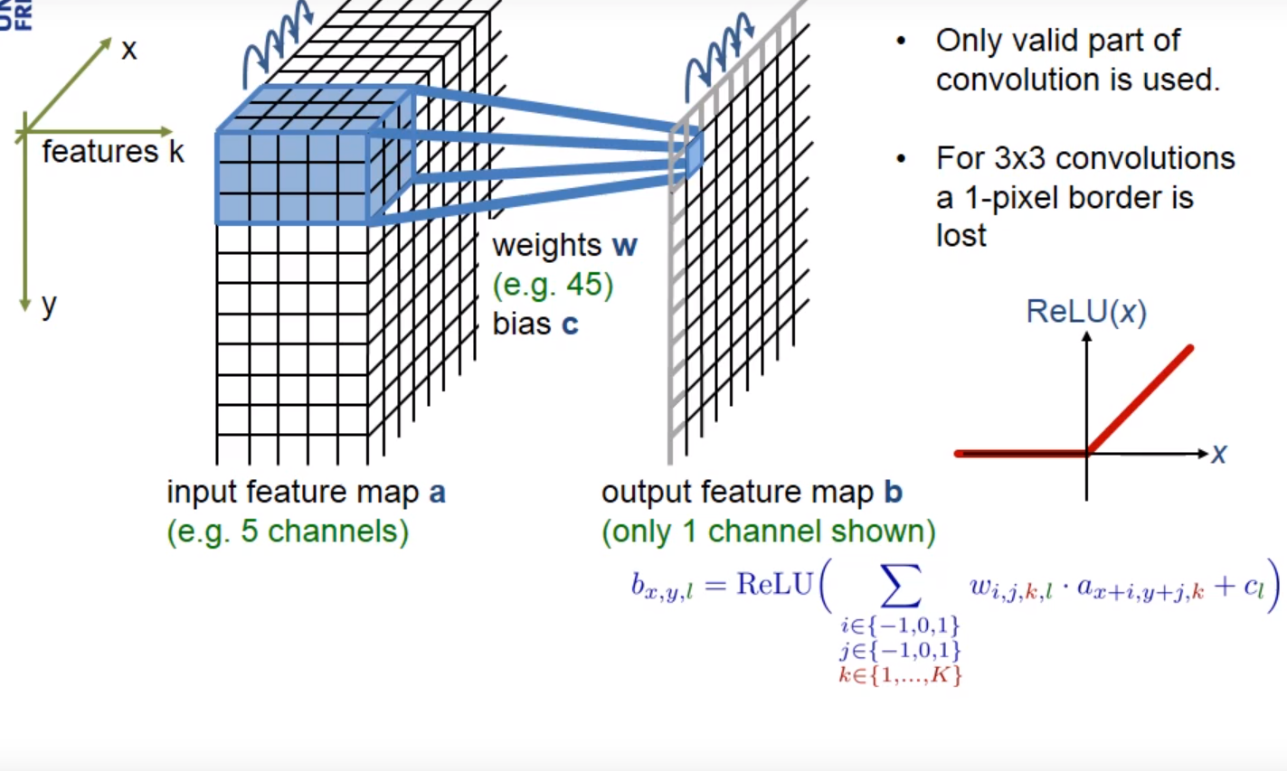
3x3 Convolution + ReLu

Slide 11
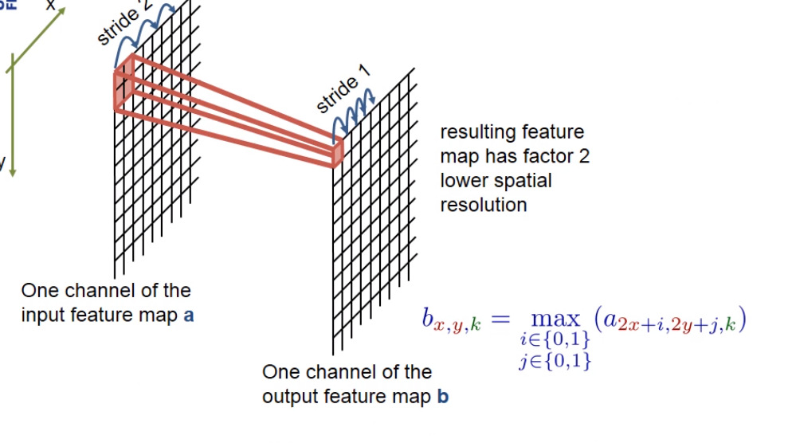
2x2 Max Pooling

Slide 12
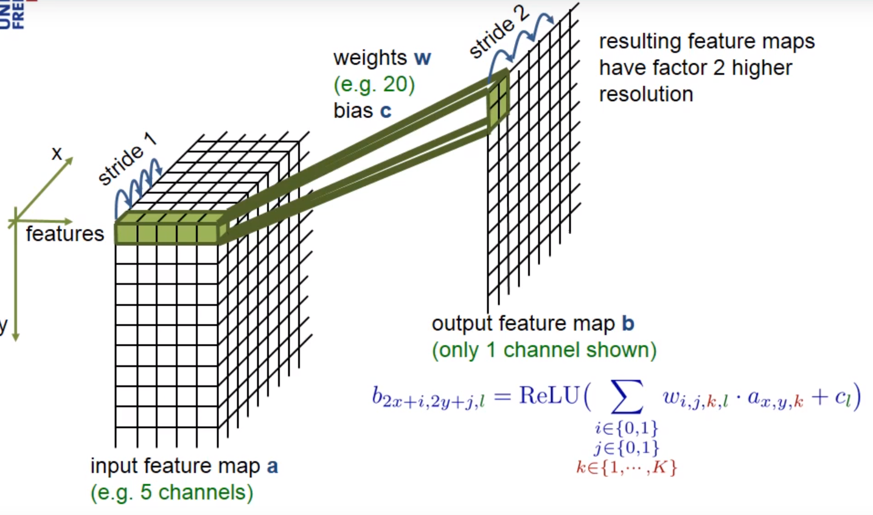
2x2 Up Convlolution

Slide 13
GAN

Slide 14
Generative Adversarial Networks
Created in 2014 by Ian Goodfellow
Semi-supervised learning
Used in Image / audio synthesis

Slide 15
Why is it Adversarial ?

Slide 16
2 components :
Generator : Replicate real data to produce fake data
Discriminator : Distinguishes real data from fake data

Slide 17
Steps to train a GAN :
Define the problem
Define GAN Architecture
Train Discriminator to distinguish “real” vs “fake” data
Train Generator synthesize data
Repeat steps 3 and 4 for N times

Slide 18
Loss Function
Discriminator is a binary classifier
Cross Entropy Loss :
H( p,q )= - p log(q) – ( 1-p ) log( 1-q )
Half sample from real dataset : x~p_data
Half sample from fake dataset : x~p_generator
D(x) : Predicted output of Discriminator
If D(x) = 0 , data is fake
Or if D(x) = 1 , data is real

Slide 19
Types of GAN :
Conditional GAN
Deep Convolutional GAN
Info GAN
Wasserstein GAN

Slide 20
CGAN

Slide 21
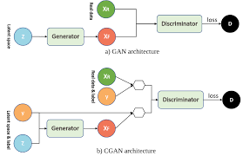
Conditional GAN
Input : Condition
Output : Specific types of output will be generated

Slide 22
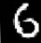
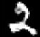
Generate a random digit
Randomly
Sampled
Data
GAN
Generator
Randomly
Sampled
Data
CGAN
Generator
2

Slide 23
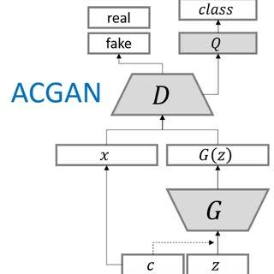
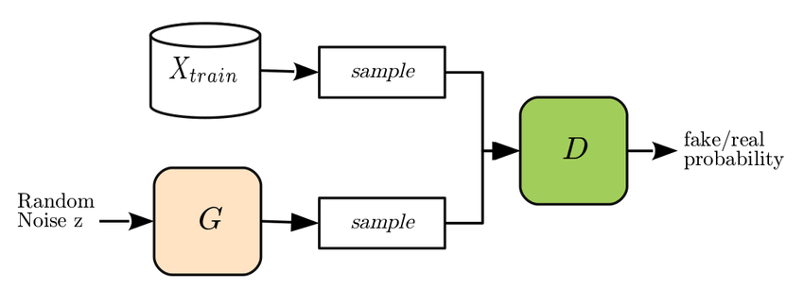

Slide 24
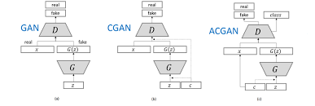

Slide 25
Methods
We combine an enhanced residual U-net generator and
an auxiliary classifier discriminator as our adversarial network.
We feed the generator with sketch maps and style
maps. Our discriminator can tell whether its input is real or
fake, and classify corresponding style simultaneously.

Slide 26


Slide 27
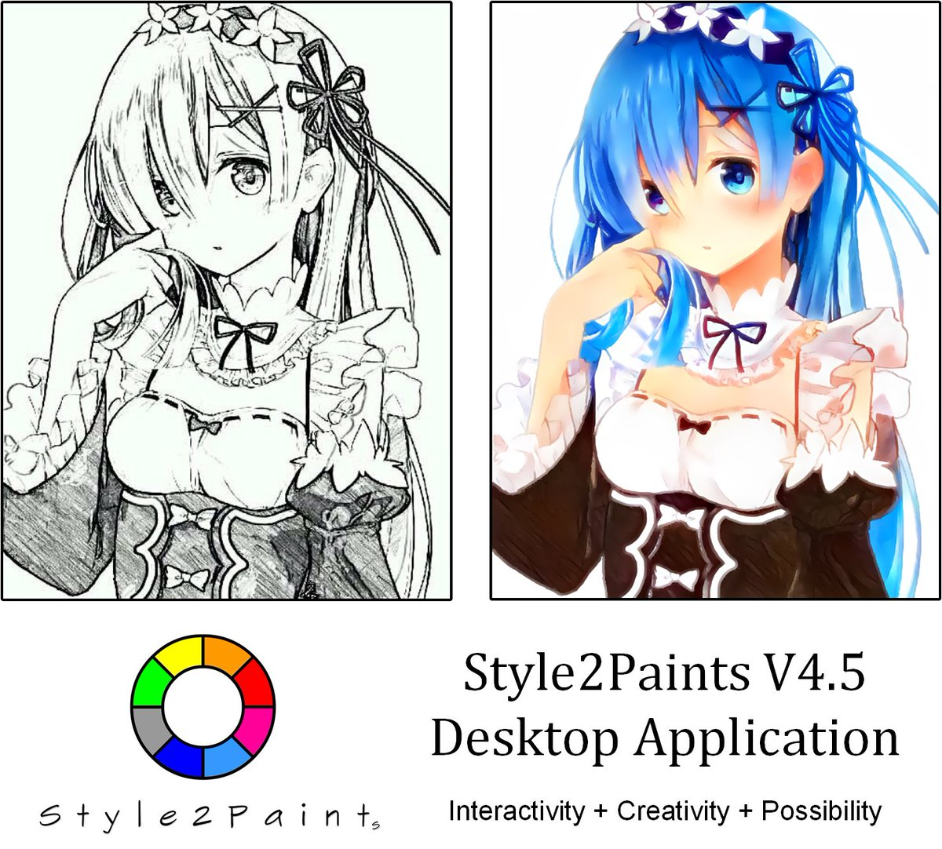

Slide 28
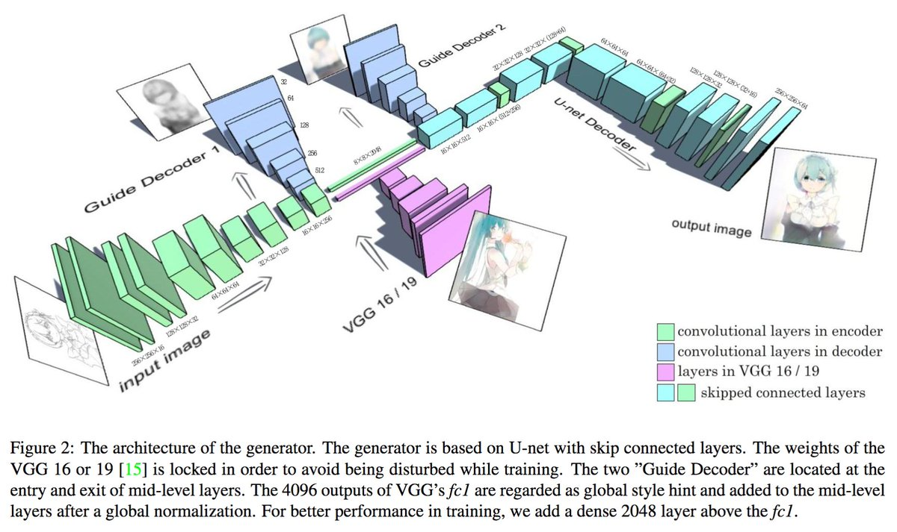

Slide 29
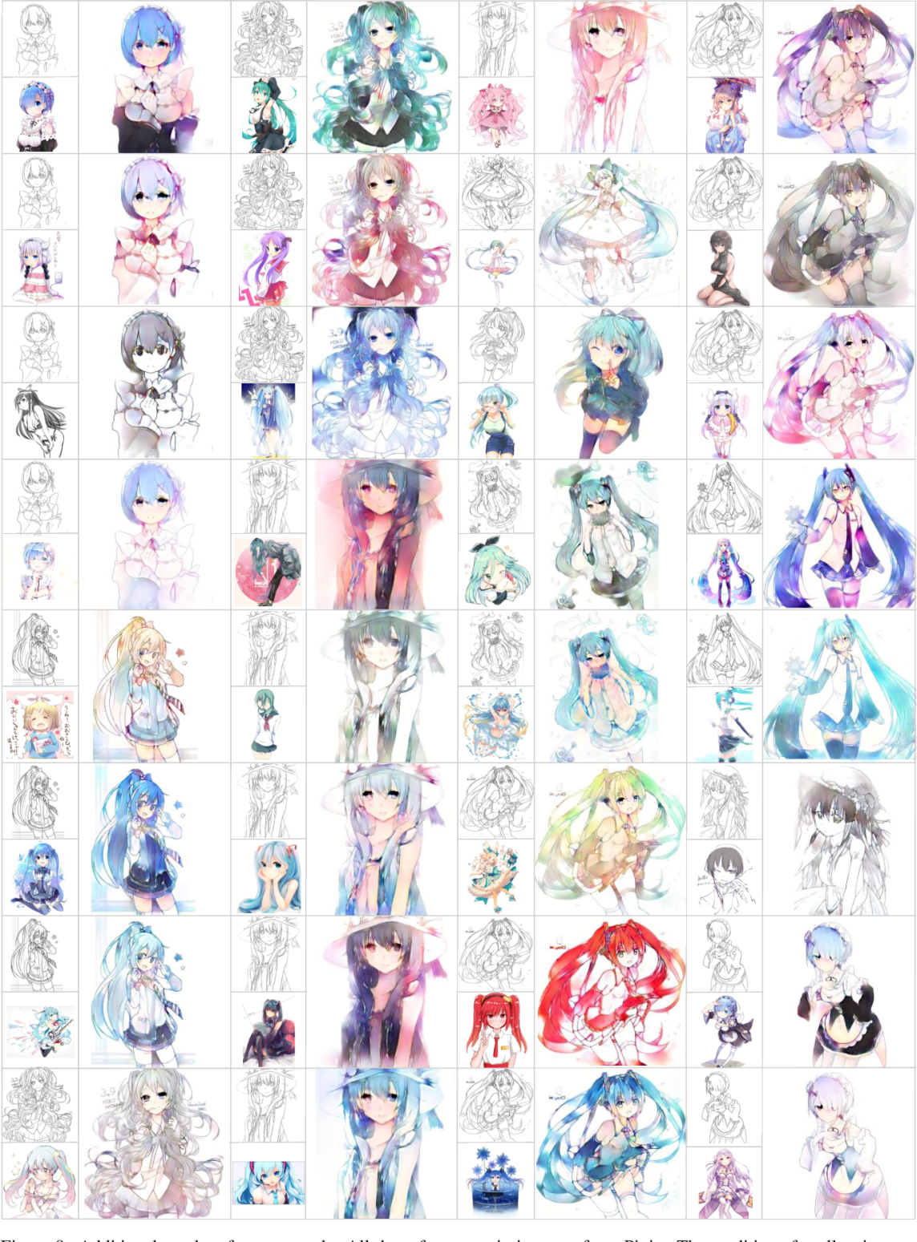

Slide 30
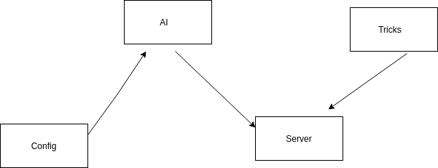

Slide 31
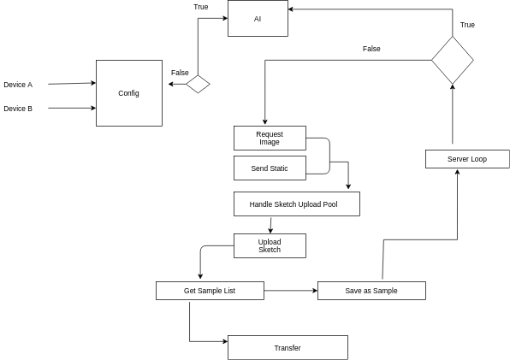

Slide 32
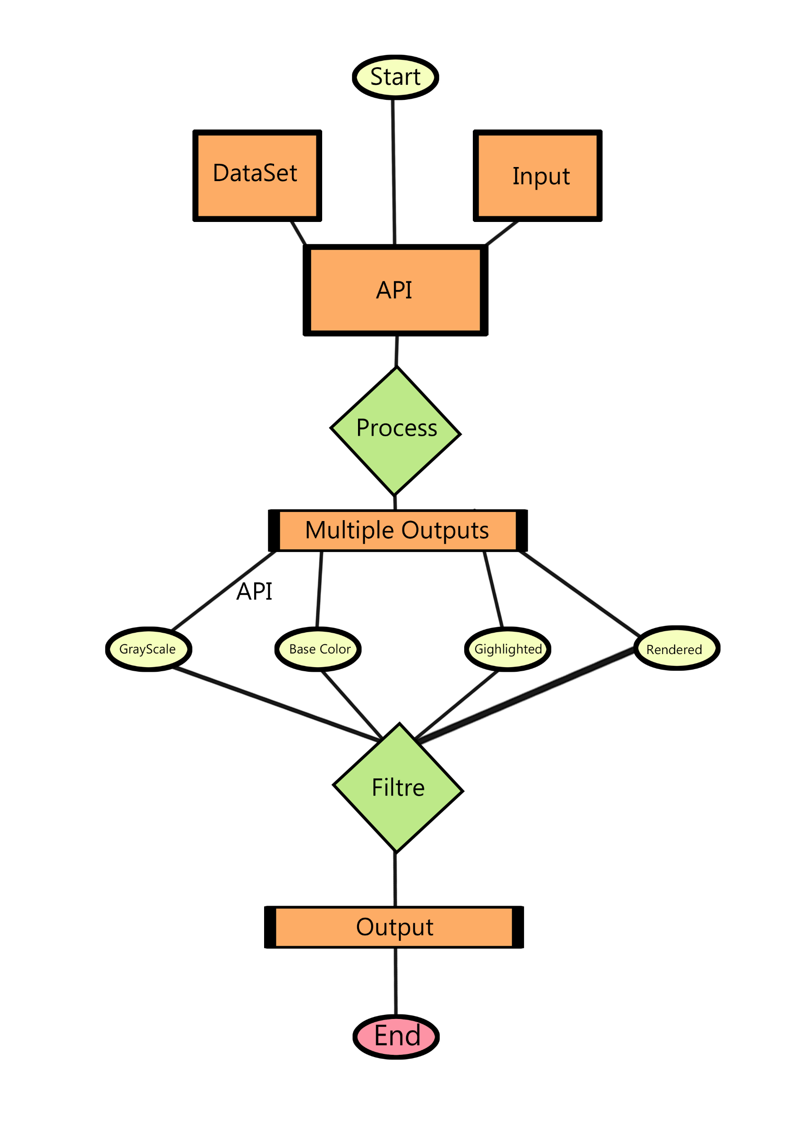
Diagram

